Slide 1
INVESTMENT ANALYTICS
DETAILED PROJECT REPORT
HILAL P V

Slide 2
Objective:
The goal of this project is to find the key metrics and factors and show the meaningful relationships between attributes of investment data set.
Benefits:
Detection of investments of FDI in the past years.
Gives better insight of sector wise investments

Slide 3
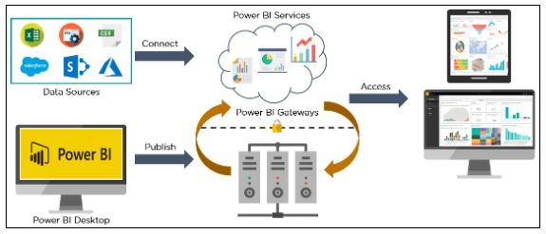
The Architecture

Slide 4
Data Description
Sector: In the 1st column, Sector names are mentioned. There are total 63 sectors like AGRICULTURAL MACHINERY, AGRICULTURE SERVICES, AUTOMOBILE INDUSTRY, COMPUTER SOFTWARE & HARDWARE etc.
Year wise – Apart from first column, years from 2000-01 to 2016-17 are mentioned the rest of the 16 columns.

Slide 5
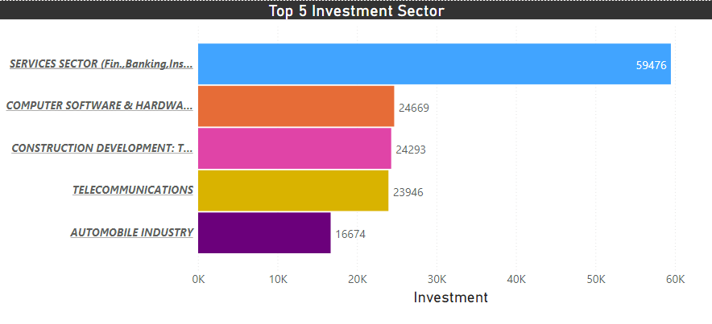
Observations
Top 5 Investment Sector
Here, the topmost sectors are displayed in which foreign investment had takes place.

Slide 6
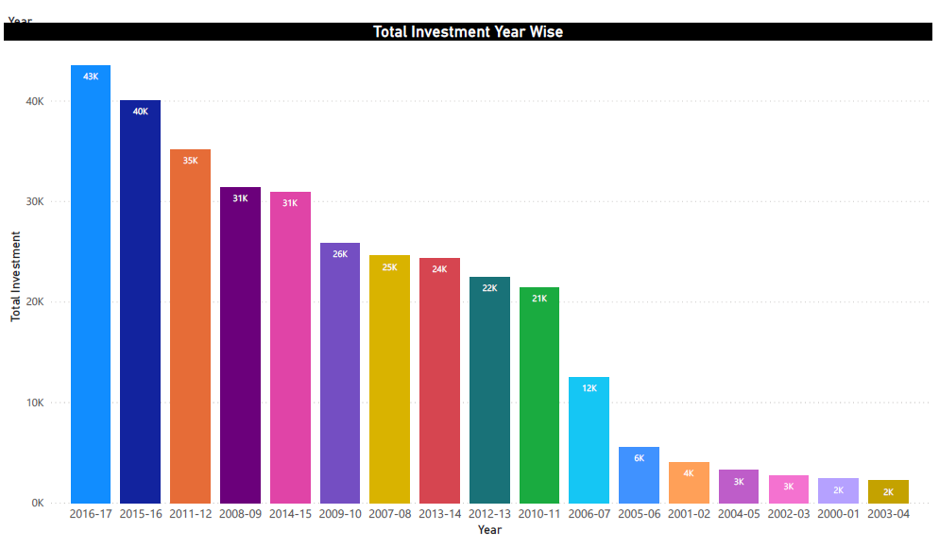
2. Total Investment Year Wise
Here, the foreign investments from year 2000-01 to 2016-17 are shown in descending order. The maximum investment are happened in the year 2016-17.

Slide 7
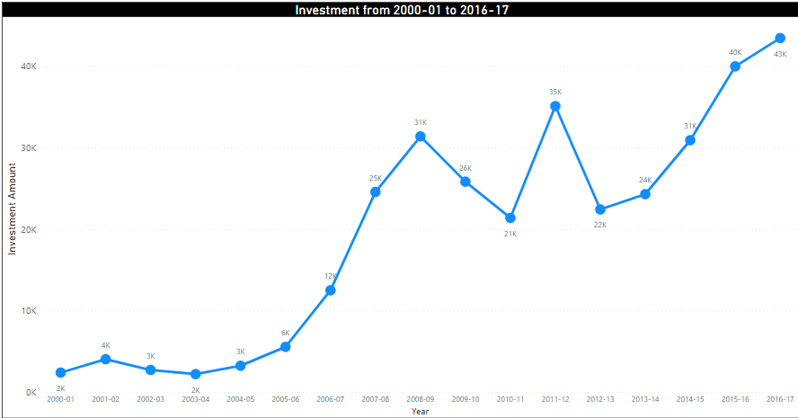
3. Investment from 2000-01 to 2016-17
The foreign investment from year 2000-01 to 2016-17 are shown below. From this graph, the trends of foreign investment are identified.

Slide 8
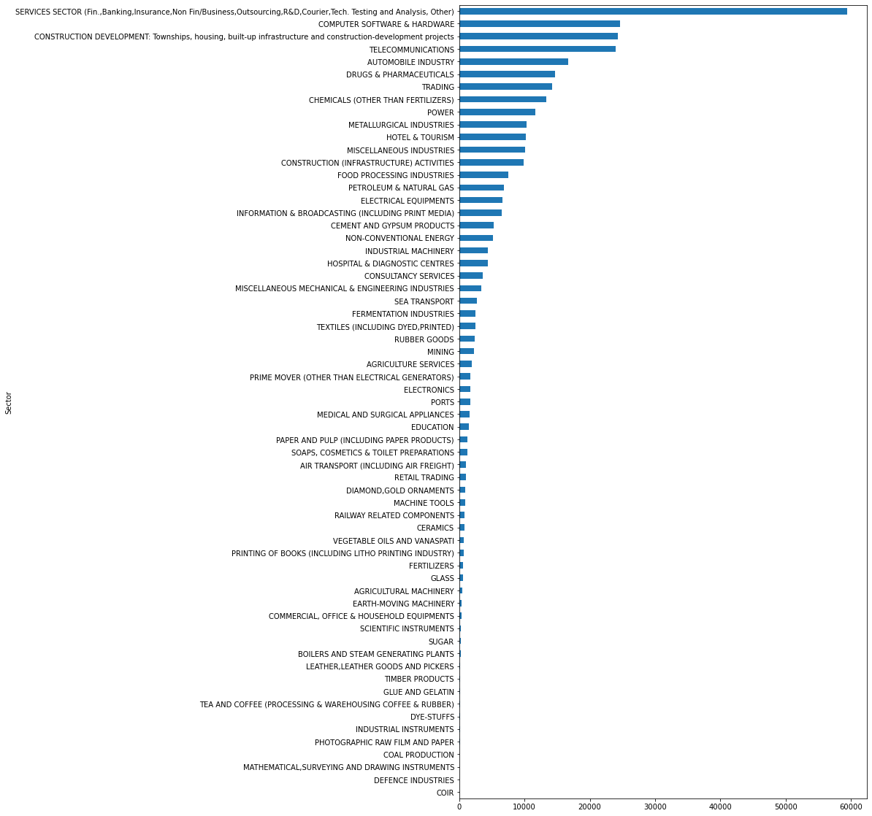
4. Sector wise investment

Slide 9
Thank You

